Slide 1
Various Types of Loops and
Decision Making in RPA UiPath
Mastering Control Flow in Automation Workﬂows

Slide 2
Understanding Control Flow in R PA
What is Control Flow?
Importance of Loops &
Decision Making
Deﬁnes the order in which actions are executed
within an automation project.
Loops (Repetition)
Determines the path an automation takes,
ensuring tasks are performed logically and
eﬃciently.
Essential for automating repetitive tasks, such as
processing items in a list or iterating through
database records (e.g., For Each, While).
Crucial for building robust, scalable, and
Decision Making (Adaptability)
adaptable automation workﬂows.
Creates intelligent workﬂows capable of handling
various scenarios and exceptions by controlling the
path based on conditions (e.g., If, Switch).
Increased Adaptability
Enhanced Robustness
Greater Eﬃciency
Enables automation to respond
dynamically to diﬀerent conditions
and scenarios.
Builds resilient processes that can
Streamlines workﬂow execution,
minimizing manual intervention and
maximizing throughput.
handle unexpected inputs or
variations gracefully.
UiPath Decision-Making Activities Overview
If Activity: Executes one of two branches (Then/Else)
Flow Decision: Visual If-statement within a ﬂowchart,
based on a boolean condition.
providing True/False paths.
Switch Activity: Selects one of multiple execution
Flow Switch: A ﬂowchart equivalent of Switch,
paths based on an expression's value.
branching based on multiple case values.

Slide 3
Looping Constructs in UiPath: An Overview
The Role of Loops in Repetitive Tasks
Loops are fundamental control ﬂow activities in UiPath, designed to automate repetitive processes eﬃciently. They enable a bot to execute a speciﬁc block of activities multiple times, either until a certain condition is met or all items within a collection have been processed. This capability is crucial for handling large volumes of similar tasks, signiﬁcantly enhancing automation accuracy and speed.
Common Scenarios for Using Loops
Data Processing: Iterating through each row of a data table, item in a list, or ﬁle within a speciﬁed directory.
Web & Application Interaction: Extracting structure data from multiple pages on a website, or repeating data entry across various forms.
Document & Email Management: Processing each unread email in an inbox, or handling individual invoices from a folder.
Batch Operations: Automating a series of steps for every record in a transaction queue.
Key UiPath Loop Activities
For Each
While Loop
Do While Loop
Iterates through each element in
a collection (e.g., array, list,
DataTable rows, ﬁles). Ideal for
processing known sets of data.
Executes a block of activities
repeatedly as long as a speciﬁed
condition remains `True`. The
condition is evaluated *before*
the loop body runs.
Similar to the While loop, but
guarantees at least one
execution. The condition is
evaluated *after* the loop body
runs.

Slide 4
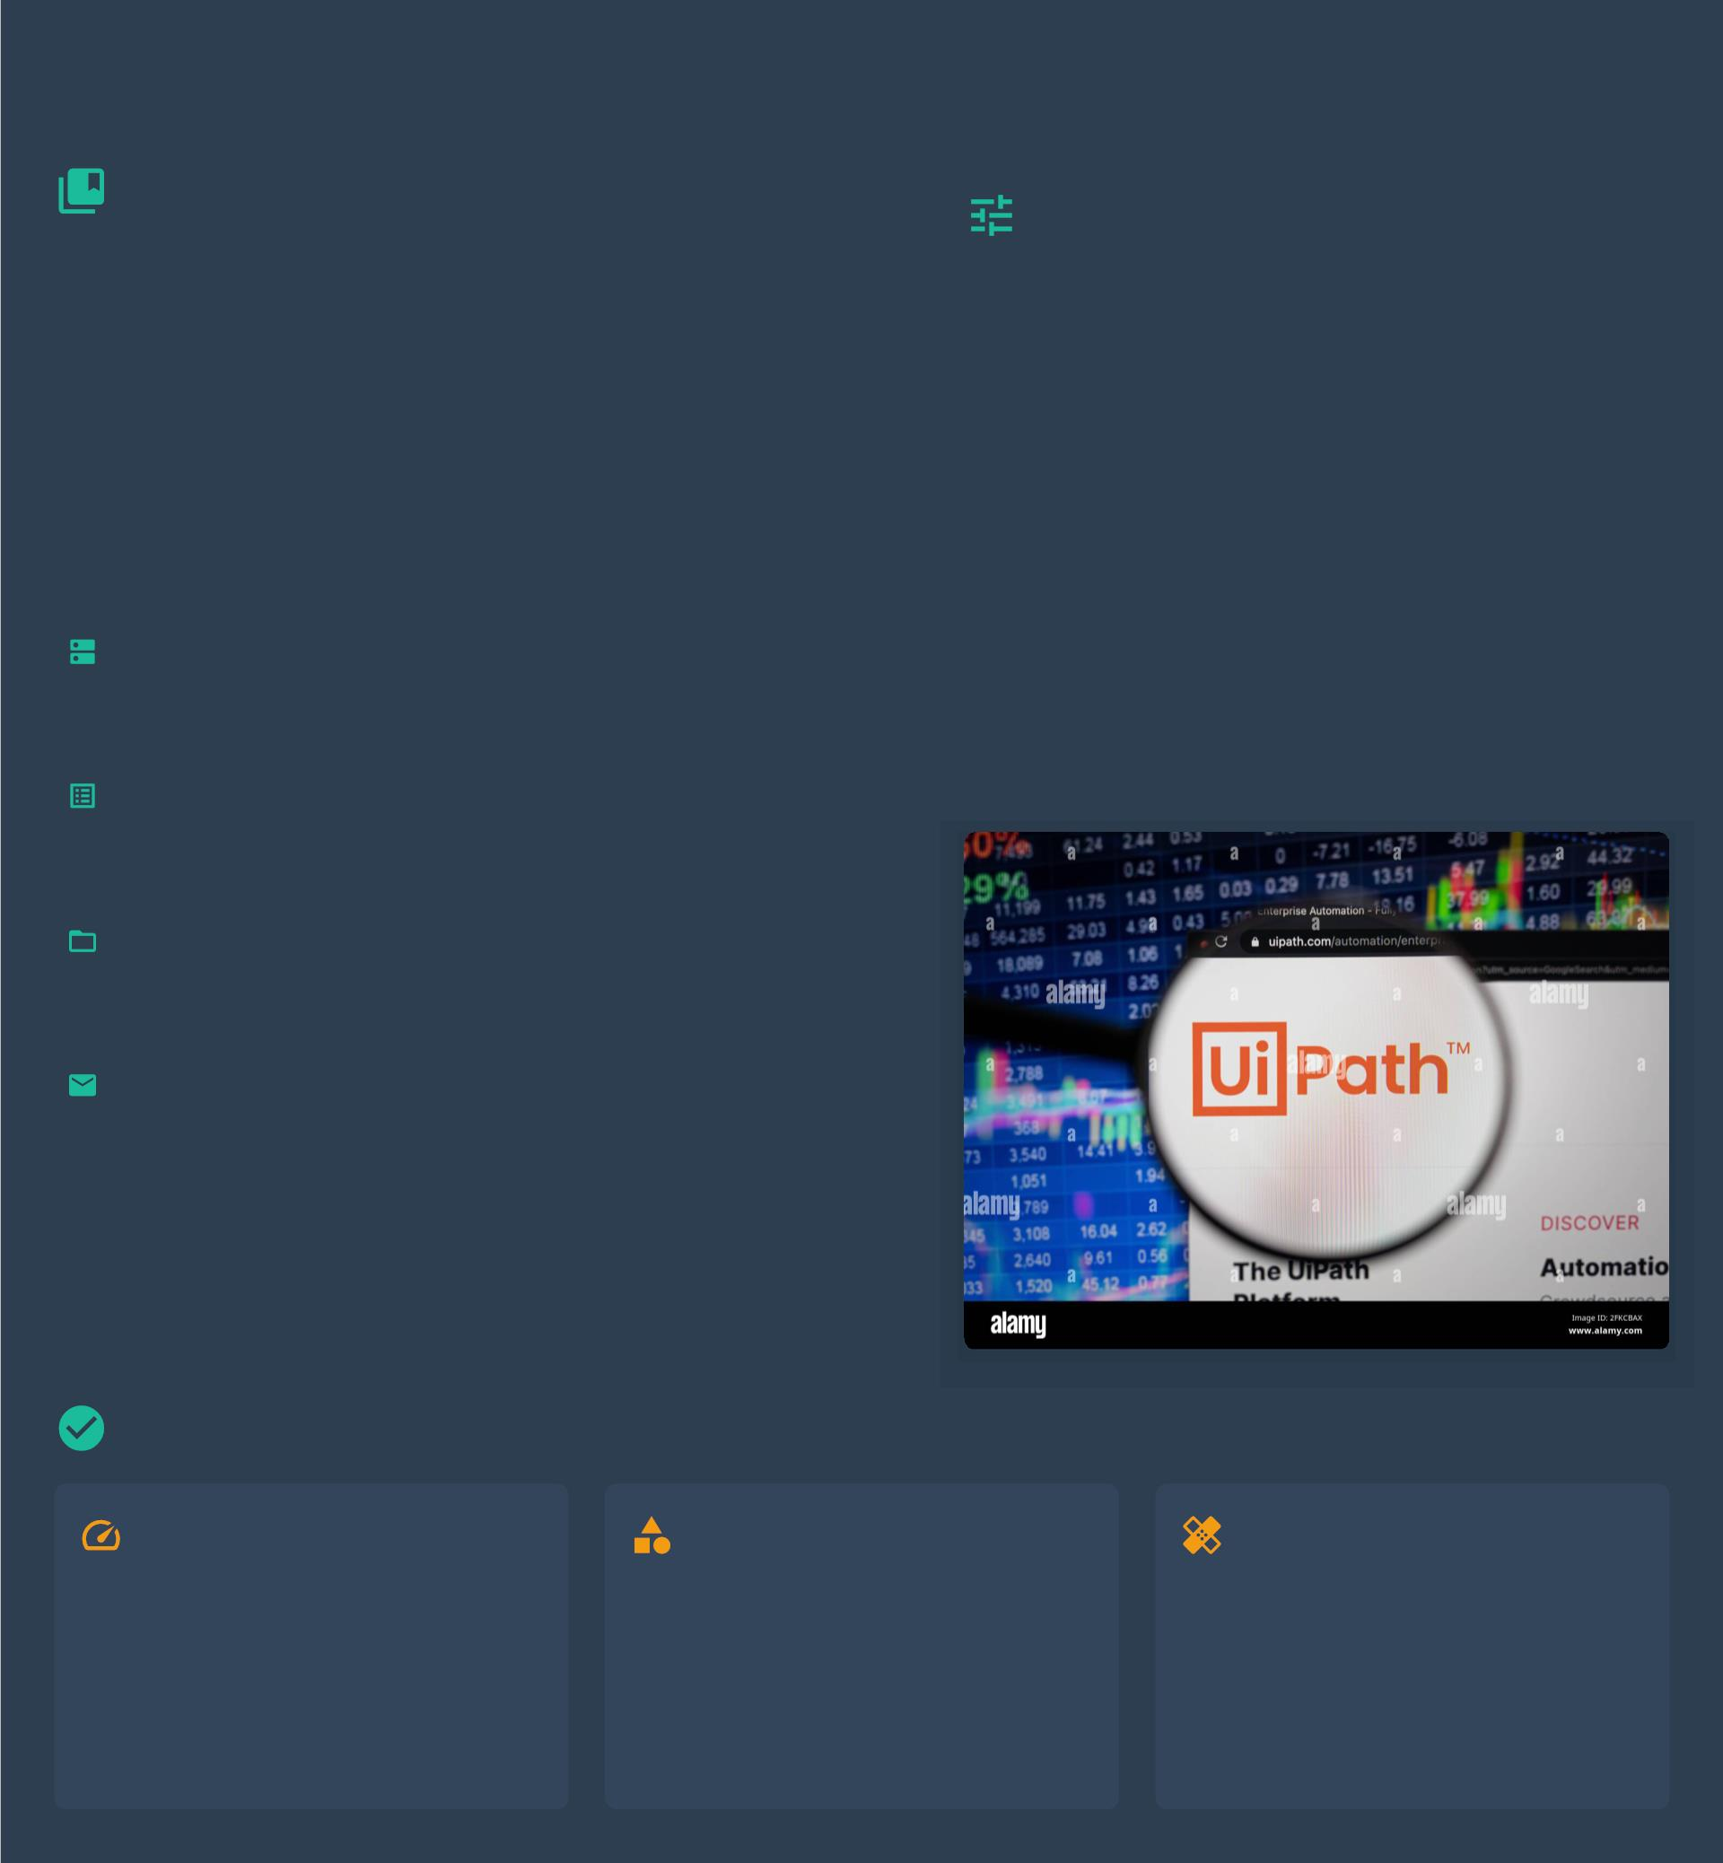
For Each Loop: Iterating Collections
Purpose & Diverse Use Cases
Conﬁguring 'For Each'
Loop
Purpose
The 'For Each' loop is a foundational control ﬂow activity
in UiPath designed to process every item within a
speciﬁed collection. It automates repetitive tasks by
executing a block of activities once for each element,
eliminating manual intervention for iterative operations.
The 'For Each' activity requires setting key
properties to deﬁne its iteration behavior:
`TypeArgument` Property
Speciﬁes the data type of the items being
iterated (e.g., `DataRow`, `String`, `Object`).
This is crucial for type safety.
Key Use Cases
`Value` Property
Iterating Processing each row of a `DataTable`,
Data
such as reading Excel data or populating
forms.
The collection variable (e.g., a `DataTable`, a
`List`, or an array) that you wish to iterate
over.
Tables:
Processing Handling elements in lists or arrays,
Lists &
Arrays:
like manipulating strings or performing
calculations.
Managing
Files &
Iterating through ﬁles in a directory
for organization or batch operations.
Folders:
Email
Processing each email in an inbox
Automation:based on certain criteria, like
downloading attachments.
Best Practices for Using For Each
Eﬃcient Processing
Proper Type Argument
Robust Error Handling
Optimize activities inside the loop
to minimize execution time. Avoid
unnecessary delays or redundant
operations within each iteration.
Always set the correct
Implement 'Try Catch' blocks
within the loop for critical
operations to gracefully handle
exceptions and ensure process
stability.
`TypeArgument` for the collection
to prevent runtime errors and
ensure proper data manipulation.

Slide 5
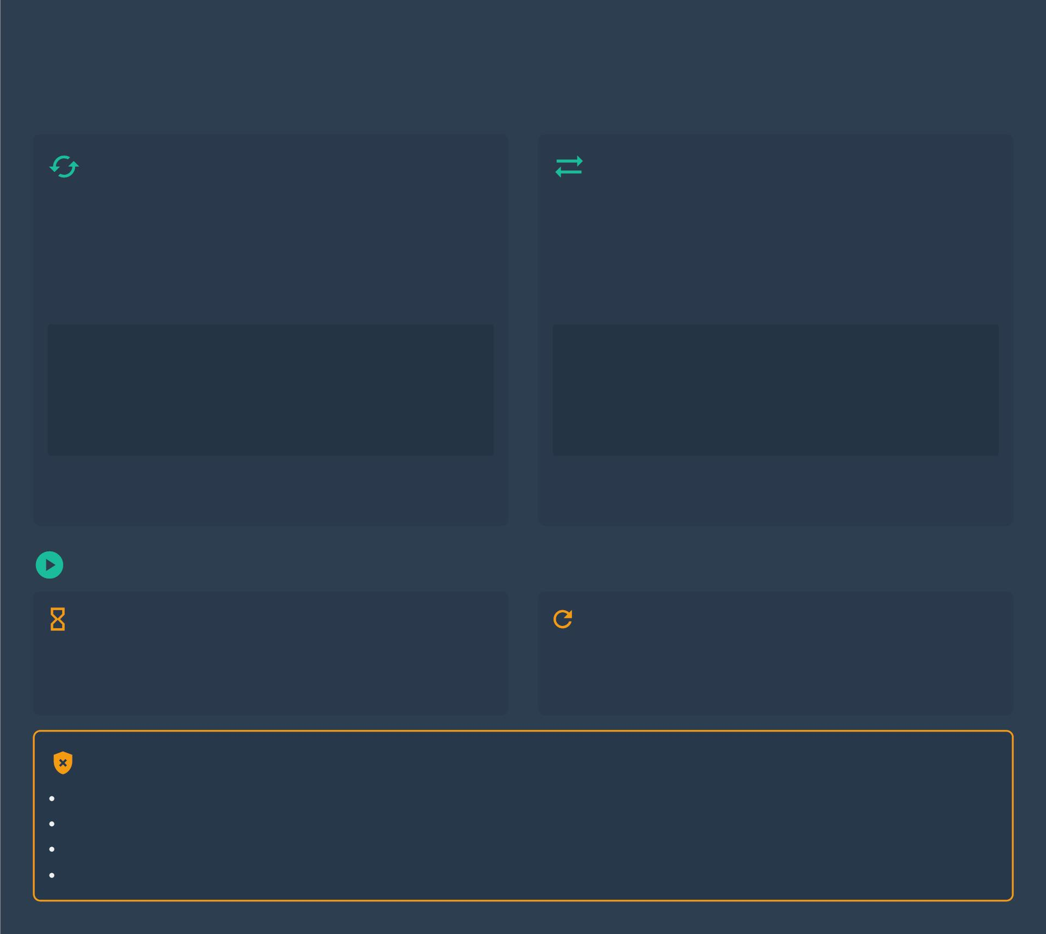
While and Do While Loops: Conditional
Repetition
While Loop Logic
Do While Loop Logic
Condition First: The 'While' loop evaluates its condition
Guaranteed First Run: The 'Do While' loop executes its
before executing the loop body.
body at least once before evaluating the condition.
Zero Execution Possible: If the condition is initially
Condition Last: The condition is evaluated after the ﬁrst
`False`, the activities within the loop will never be executed.
execution, and then repeatedly if `True`.
Flow:
Flow:
Check Condition
IF True:
Execute Body
Check Condition
IF True:
Execute Body
Repeat Check Condition
IF False:
Repeat Execute Body
IF False:
Exit Loop
Exit Loop
Analogy: Checking if the door is open *before* trying to
Analogy: Trying to open the door *then* checking if it's
walk through it. If it's closed, you don't even try.
unlocked. Even if it's locked, you've already tried once.
Practical Applications
Waiting for UI Elements
Implementing Retries
Use a While loop to repeatedly check for a UI element (e.g.,
button, text ﬁeld) until it appears or a timeout is reached.
This prevents failures from slow-loading elements.
Use a Do While loop to attempt an action that might fail
intermittently (e.g., API call). It ensures the action is tried
once and retried until successful or a limit is hit.
Critical: Ensuring Loop Termination
Avoid Inﬁnite Loops: Always design loop conditions to eventually become false.
Implement Counter Variables: Use counters to limit the number of iterations and prevent runaways.
Set Timeouts: For UI or network tasks, use timeouts to escape indeﬁnite waits.
Robust Error Handling: Use `Try Catch` blocks to manage exceptions that can aﬀect loop conditions.

Slide 6
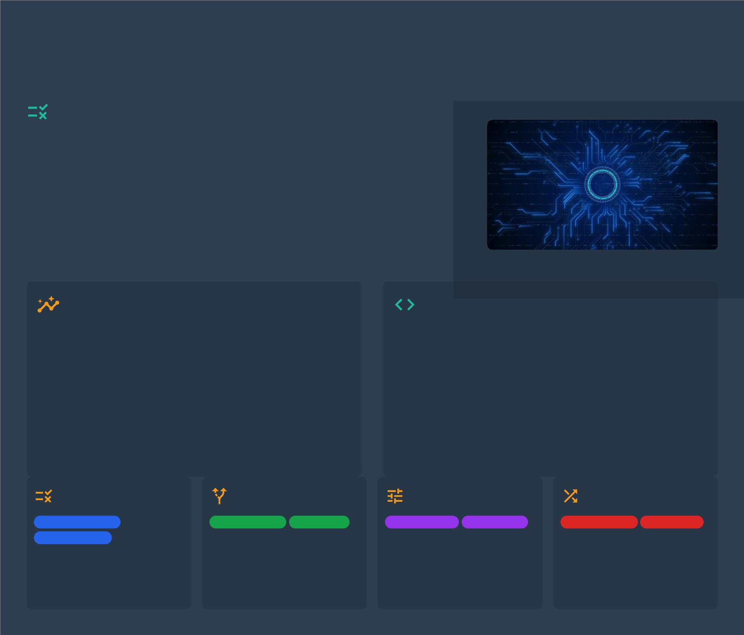
Decision Making: Controlling Workﬂow
Paths
What is Decision Making in
Automation?
Decision making in automation refers to the process where a robot (bot)
evaluates speciﬁc conditions to determine the subsequent path or action
to take within a workﬂow.
It allows the automation to dynamically respond to varying inputs, data,
system states, moving beyond simple linear execution.
Essentially, decisions introduce 'intelligence' by enabling the workﬂow to
branch into diﬀerent logical sequences.
Why is it Crucial?
UiPath Decision Activities
Intelligent Workﬂows: Enables adaptable automation
UiPath provides a rich set of activities speciﬁcally designed
for implementing decision-making logic within automation
workﬂows.
that handles diverse scenarios and exceptions dynamically.
Scenario Handling: Crucial for processes where ﬂow
depends on data validity, user input, or business rules.
These activities empower developers to deﬁne conditional
paths, allowing the robot to execute diﬀerent sequences of
actions.
Eﬃciency & Accuracy: Bots make real-time choices,
making processes robust and more eﬃcient.
Error Prevention: Helps in implementing eﬀective error
Mastering these is fundamental for building sophisticated,
resilient, and adaptive RPA solutions.
handling and recovery paths.
If Activity
Flow Decision
Switch Activity
Flow Switch
Conditional Logic
True/False Path
Flowchart Only
Visual Flow
Multiple Paths
Default Case
Flowchart Only
Case Values
Similar to If but used exclusively
in a Flowchart, providing a clear
visual representation of
Selects one of multiple
The ﬂowchart equivalent of the
Switch, allowing multiple
outgoing branches for speciﬁc
cases.
Executes one set of activities if
a condition is `True`, and
another (optional) set if it is
`False`.
execution paths based on the
value of a speciﬁed expression.
branching logic.

Slide 7
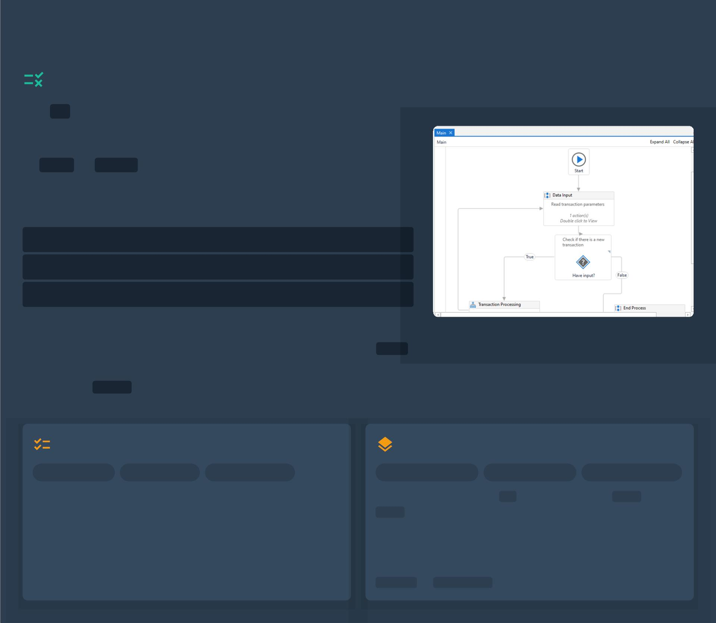
If Activity: Simple Conditional Logic
Syntax & Branching Logic
The If activity is a fundamental decision-making construct
in UiPath, enabling the automation to execute diﬀerent sets
of activities based on whether a speciﬁed condition evaluate
to True or False .
Key Property: Condition
This property requires a Boolean expression. Examples include:
TotalAmount > 100
String.IsNullOrEmpty(CustomerName)
File.Exists("path\\to\\file.txt")
Handling Branches
The If activity is dragged from the Activities panel
to control the workﬂow path.
Then Branch: Contains activities executed if the Condition is True
Else Branch: Optional branch with activities executed if the
Condition is False . If empty, the workﬂow proceeds to the next
activity.
Common Applications
Nesting If Activities
Data Validation
Business Rules
Dynamic Routing
Complex Conditions
Hierarchical Logic
Readability Caution
Data Validation: Checking if input ﬁelds are populated,
Deﬁnition: Placing one If activity inside the Then or
Else branch of another.
values are in range, or data formats are correct.
Business Logic: Implementing diﬀerent process ﬂows
Purpose: Handles complex, hierarchical decision ﬂows
based on speciﬁc business rules (e.g., approving invoices).
where multiple conditions must be evaluated sequentially.
Branching Logic: Directing automation based on conditions
Caution: Excessive nesting hinders readability. Consider
like ﬁle existence or system status.
Switch or Flowchart
for clarity in complex scenarios.
Source: Understanding Decision-Making Activities in UiPath - Medium; UiPath Documentation; Edureka

Slide 8
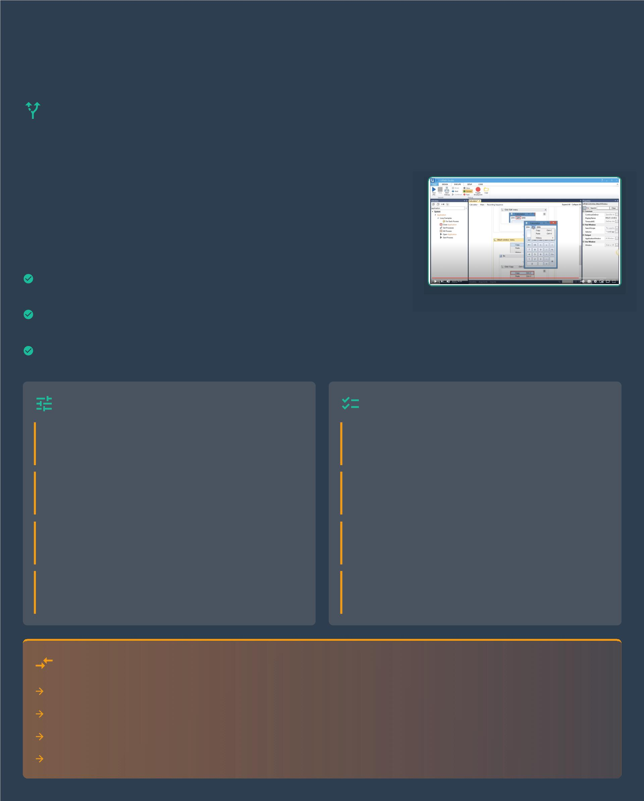
Switch Activity: Multiple Path
Selection
Purpose & Advantages of the Switch
Activity
Core Purpose
The `Switch` activity in UiPath is a control ﬂow mechanism designed to
select one of several execution paths based on the value of a single
speciﬁed expression. It evaluates an input value against a list of predeﬁned
'case' values, executing the activities associated with the ﬁrst matching
case.
Key Advantages
Clarity &
Dramatically improves workﬂow readability compared to
Readability: lengthy `If-Else If` chains.
Maintainability:Easier to manage and update new conditions or paths
without restructuring the workﬂow.
Organization:Provides a clear, structured way to categorize and handle
diverse outcomes.
Conﬁguring Cases & Default
Practical Examples in RPA
`Expression` Property
Menu Selections
Provide the variable or value to be evaluated. Common
types include `String` and `Int32`.
Processing user input like '1' for New Order, '2' for Check
Status, '3' for Exit.
`TypeArgument` Property
Status Handling
Speciﬁes the data type of the `Expression` and `Case`
values to ensure compatibility.
Automating actions based on a status: 'Pending',
'Approved', 'Rejected', 'On Hold'.
`Case` Branches
Categorizing Data
Create a branch for each speciﬁc value you want to
handle. Activities inside execute only on a match.
Routing invoices by type: 'Purchase Order', 'Credit Memo',
'Utility Bill'.
`Default` Option
Processing File Extensions
Perform actions on ﬁles based on extension: `.xlsx`,
`.pdf`, `.txt`.
An optional fallback path that executes if no `Case`
branch matches the expression's value.
When to Prefer Switch over Nested Ifs
Use `Switch` for 3+ distinct, mutually exclusive conditions based on a single variable.
It is visually cleaner and far more readable than long chains of `If-Else If` statements.
Adding or removing a case is safer and simpler than modifying deeply nested `If` conditions.
Prevents the 'pyramid of doom' from excessive nesting, leading to more robust workﬂows.

Slide 9
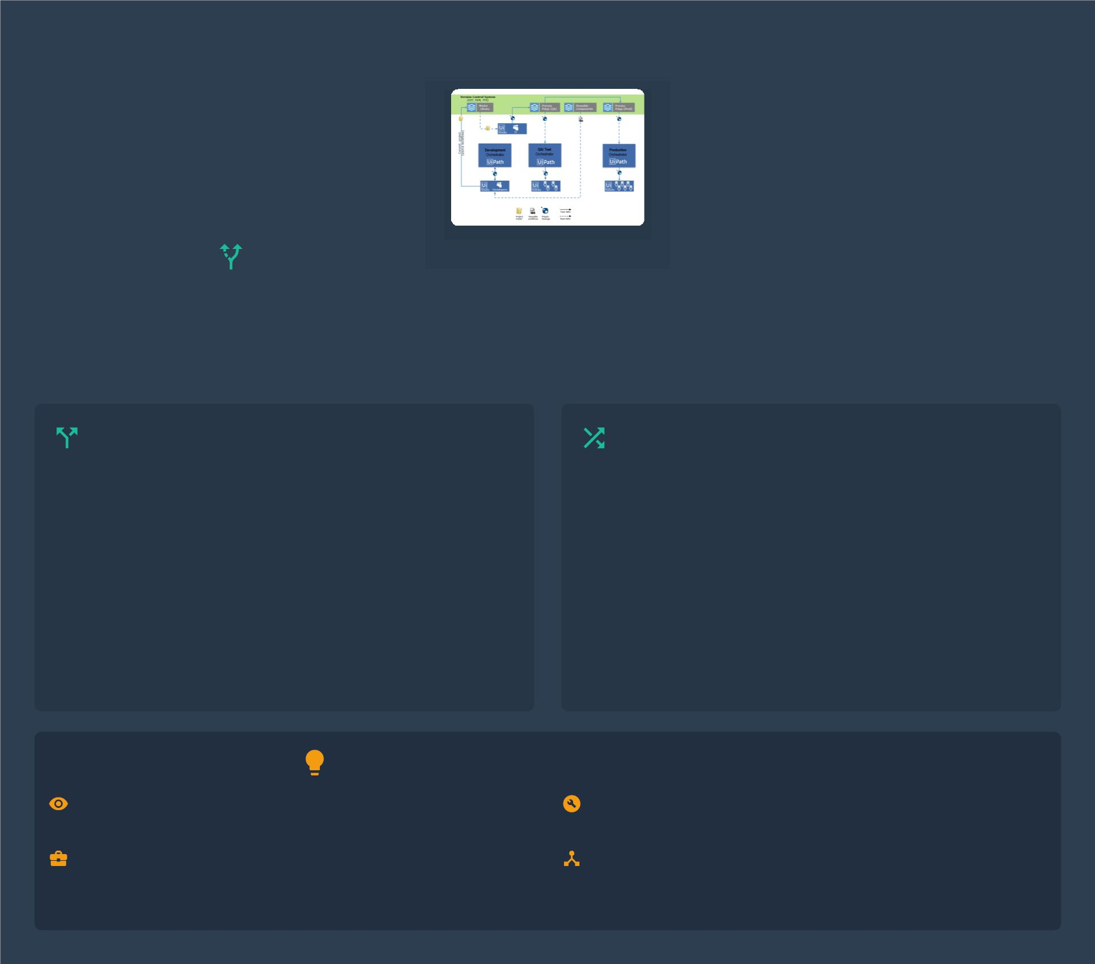
Flowchart Decision and Flow Switch
Visualizing Workﬂows: Flowchart Activities
Flowcharts in UiPath oﬀer a powerful, visual, and diagrammatic approach to designing automation, particularly
suited for processes with complex decision points and non-linear logic. Unlike Sequences, Flowcharts enable
readable, interconnected activities and decision points represented graphically, enhancing clarity and
maintainability.
Flow Decision: Binary Branching
Flow Switch: Multi-Path Selection
The Flow Decision activity is an essential component
within Flowcharts designed to handle binary (True/False)
conditional logic.
The Flow Switch is the Flowchart equivalent of the Switch
activity, enabling a workﬂow to branch into multiple distinct
execution paths.
It takes a Condition (a Boolean expression) and provides
two distinct output branches: a True branch and a False
branch.
It evaluates an expression and directs the ﬂow to a speciﬁc
Case branch that matches the expression's value.
An optional Default branch is available to handle scenarios
where the value does not match any deﬁned cases,
ensuring robust error handling.
This activity visually represents a clear fork in the
automation path, directing the workﬂow down one of two
speciﬁc sequences based on the evaluation.
Why Flowcharts Excel in Complex Logic
EnhancedProvides a bird's-eye view of complex
Improved
Maintainability: debugging and modiﬁcations.
Flexible Natively supports complex patterns like
Control Flow: parallel execution and loops.
The visual structure simpliﬁes
Clarity: processes, making intricate logic easy to follow.
Direct
Aligns naturally with business process
diagrams, improving collaboration.
Business
Mapping:

Slide 10
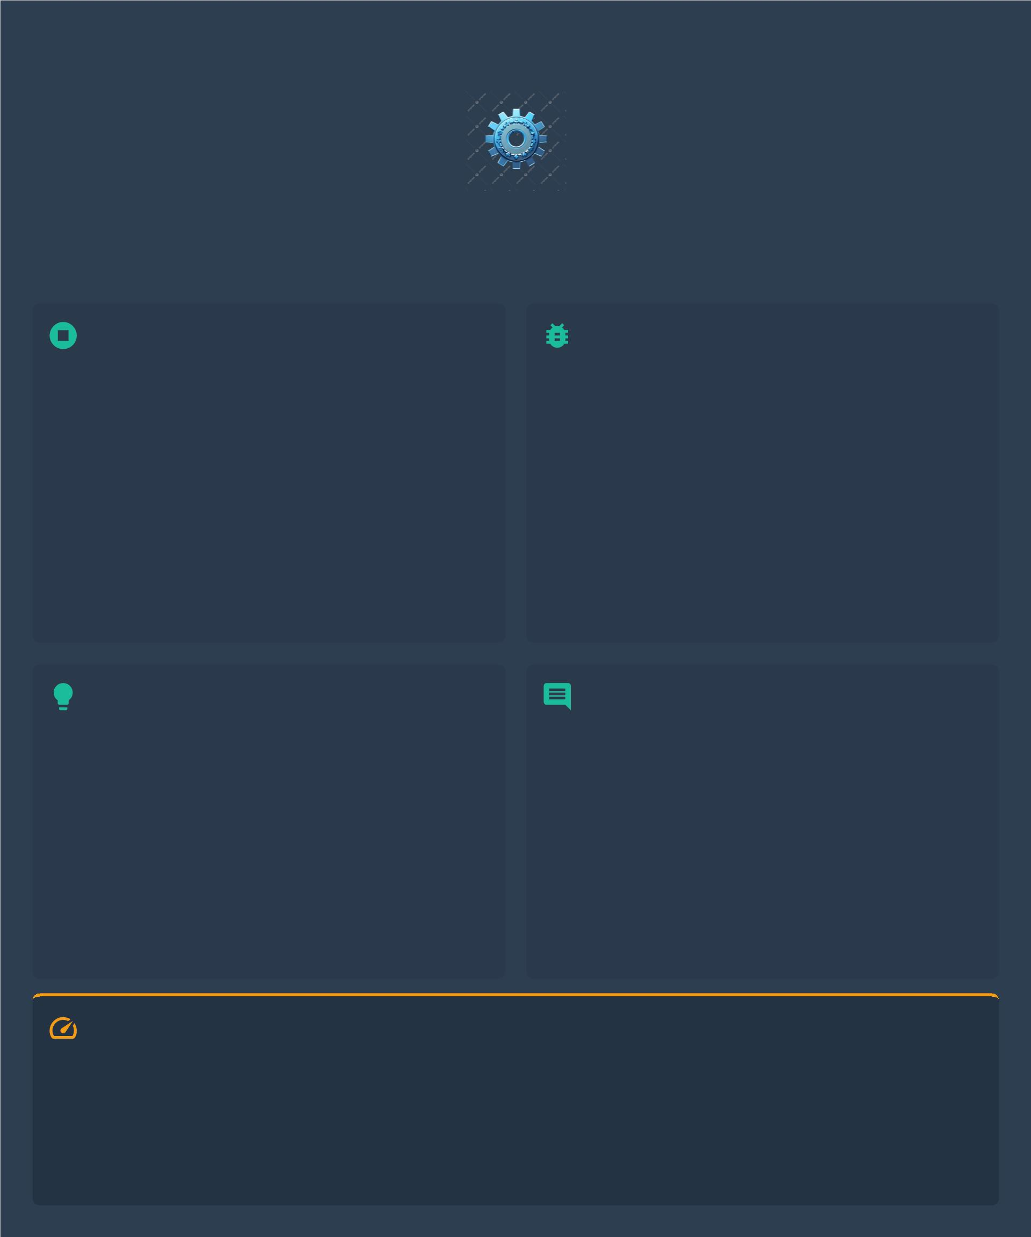
Best Practices for Loops and Decisions
Implementing robust and eﬃcient automation workﬂows requires adherence to key best
practices when designing loops and decision logic. These guidelines ensure
maintainability, reliability, and optimal performance.
Ensuring Loop Termination
Handling Exceptions in Loops
Avoid Inﬁnite Loops: Design all loops with clear,
veriﬁable exit conditions to prevent halting
automation or consuming excessive resources.
Utilize `Try Catch` Blocks: Wrap volatile activities
inside loops with `Try Catch` to prevent a single error
from crashing the entire process.
Implement Counters & Timeouts: Use a counter
and max iteration limit for `While` loops. Apply
explicit timeouts for UI interactions to prevent
indeﬁnite waiting.
Granular Error Logging: Implement detailed
logging in the `Catch` block to record speciﬁc errors
and data context for eﬀective debugging.
Deﬁne Recovery Strategies: Determine the
process for errors: skip item, retry, notify a human,
or gracefully exit the loop.
State Change Conditions: Ensure variables driving
the loop are modiﬁed within its body to guarantee
the termination condition is eventually met.
Clear & Maintainable Logic
Annotations & Comments
Prefer `Switch` over Nested `If`s: For multiple
outcomes from a single variable, `Switch` is cleaner
than deeply nested `If-Else If` chains.
Document Thoroughly: Use `Annotation` to
explain the purpose of activities, complex logic, and
business rules.
Leverage Flowcharts: For complex decision trees,
`Flowcharts` oﬀer superior visual clarity and easier
management of branching logic.
Descriptive Naming: Give meaningful names to
activities, variables, and workﬂows to improve
readability.
Keep Conditions Concise: Write clear,
unambiguous Boolean expressions. Break down
complex conditions into simpler decisions.
Explain Why, Not Just What: Comments should
focus on why a structure was chosen, its context, or
non-obvious implications.
Critical: Performance Considerations
• Minimize activities inside high-volume loops.
• Cache static or infrequently changing data outside of
loops.
• Optimize UI interactions; prioritize background
automation.
• Choose eﬃcient data structures (e.g., DataTable vs.
List).
• Avoid excessive `Delay` activities within loops.

